Slide 1
HOUSE RENT PREDICTOR
AARDRA.R.NAIR CB.SC.I5DAS19001
AIYSHWARYA . A CB.SC.I5DAS19005
NIVEDHA . A CB.SC.I5DAS19023
DHANUSHKA SHREE CB.SC.I5DAS19036
Instructor: Prajna Dora
Course Code: 18CSC383
Course Name: Machine Learning Lab

Slide 2

PROJECT DESCRIPTION
This research predicts house rent prices in one of India's major metropolises .
Supervised machine learning (continuous)
4 algorithms are compared and we select the best one
The csv file is imported as a data frame using pandas
Later we clean the data set and prepare it for machine learning techniques.

Slide 3
SIGNIFICANCE
Determining the sale price of a house is quite crucial nowadays, since the cost of land and house rises year after year.
Right price helps customer to find right time to buy, invest , and make rightful choices to gain profit.
Therefore it needs some prediction tool to say if the price is reasonable or not.
This project gives the best algorithm to predict the house rent.

Slide 4
NEED
Investing in the housing or estates business appears to be a lucrative option.
Real estate is not only a basic human need, but it also reflects a person's wealth and status in today's society.
Real estate investing appears to be profitable in general since property values do not depreciate rapidly.
Change of price or lack of knowledge in the prices of the current real estates may affect various investors in households, bankers, policy makers and many others
Predicting the value of immovable property is therefore an important economic index.

Slide 5
APPLICATION
Rental market
Product price prediction
Stock market
Investment
Sales prediction
Salary prediction ( linear regression )
Age prediction ( linear regression )

Slide 6

MOTIVATION
The main motivation of this project is to make it easy for people to estimate the price by the known values ( sq units and no. of bedroom flats ) so that they can easily predict and know which real estates can be profitable beforehand so that can be acted accordingly.

Slide 7
DESCRIPTION OF DATASET
NUMBER OF ATTRIBUTES: 4
KIND OF ATTRIBUTES:
INDEX : UNIQUE VALUES integer
DESCRIPTION : string
PRICE : float
SQ FEET : integer
NATURE OF OUTPUT EXPECTED: prediction of price - NUMERICAL

Slide 8
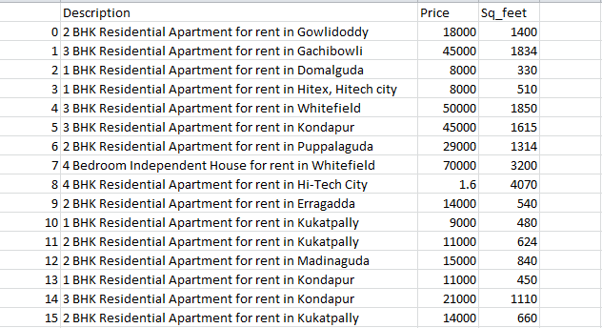
LINK TO FULL DATASET : house_rent.csv
SAMPLE DATASET :

Slide 9
CHALLENGES
As the initial house price prediction were challenging, it required some best method to get accurate prediction.
Data quality is a key factor to predict the house prices and missing features(NaN) )are a difficult aspect to handle in machine learning models let alone house prediction model.
In this study, several methods of prediction were compared to finding the best predicted results in determining a house's selling price compared to the actual price.
This project brings the latest research on regression technique that can be used for house prediction such as Linear regression, KNN , Logistic regression , Random Forest
To find the best algorithm among these algorithm R^2 method is used to find the accuracy.

Slide 10
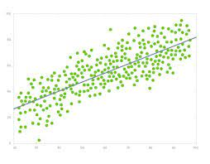
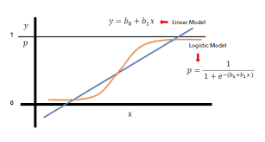
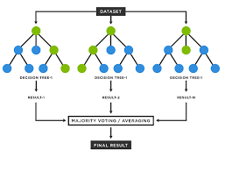
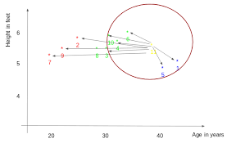
LOGISTIC REGRESSION
LINEAR REGRESSION
KNN
RANDOM FOREST

Slide 11
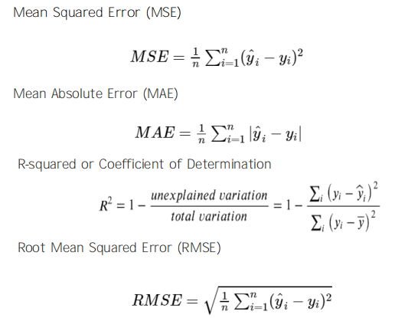
LINEAR REGRESSION

Slide 12
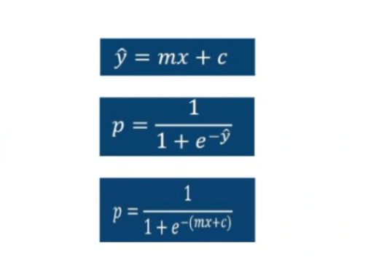
LOGISTIC REGRESSION

Slide 13
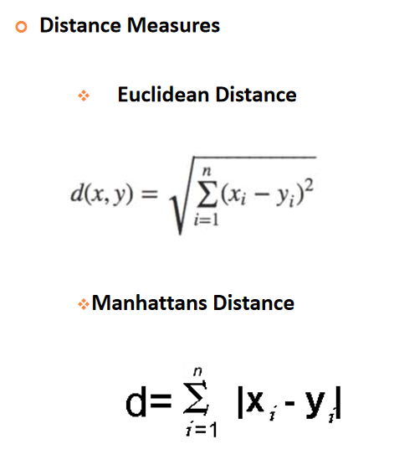
KNN ALGORITHM

Slide 14





STEPS : FLOW CHART
RAW DATA
PRE PROCESSING
PROCESSED DATA
FITTED MODEL
TRAINING

Slide 15
THANK YOU

